Slide 1

Systemic risks in Armenia: A Growth-at-Risk approach (2024Q3)
Vladimir Yeghiazaryan, Arthur Grigoryan
Central Bank of Armenia
Important disclaimer: The views expressed in this paper are those of authors, and do not necessarily represent the views of the Central Bank of Armenia

Slide 2
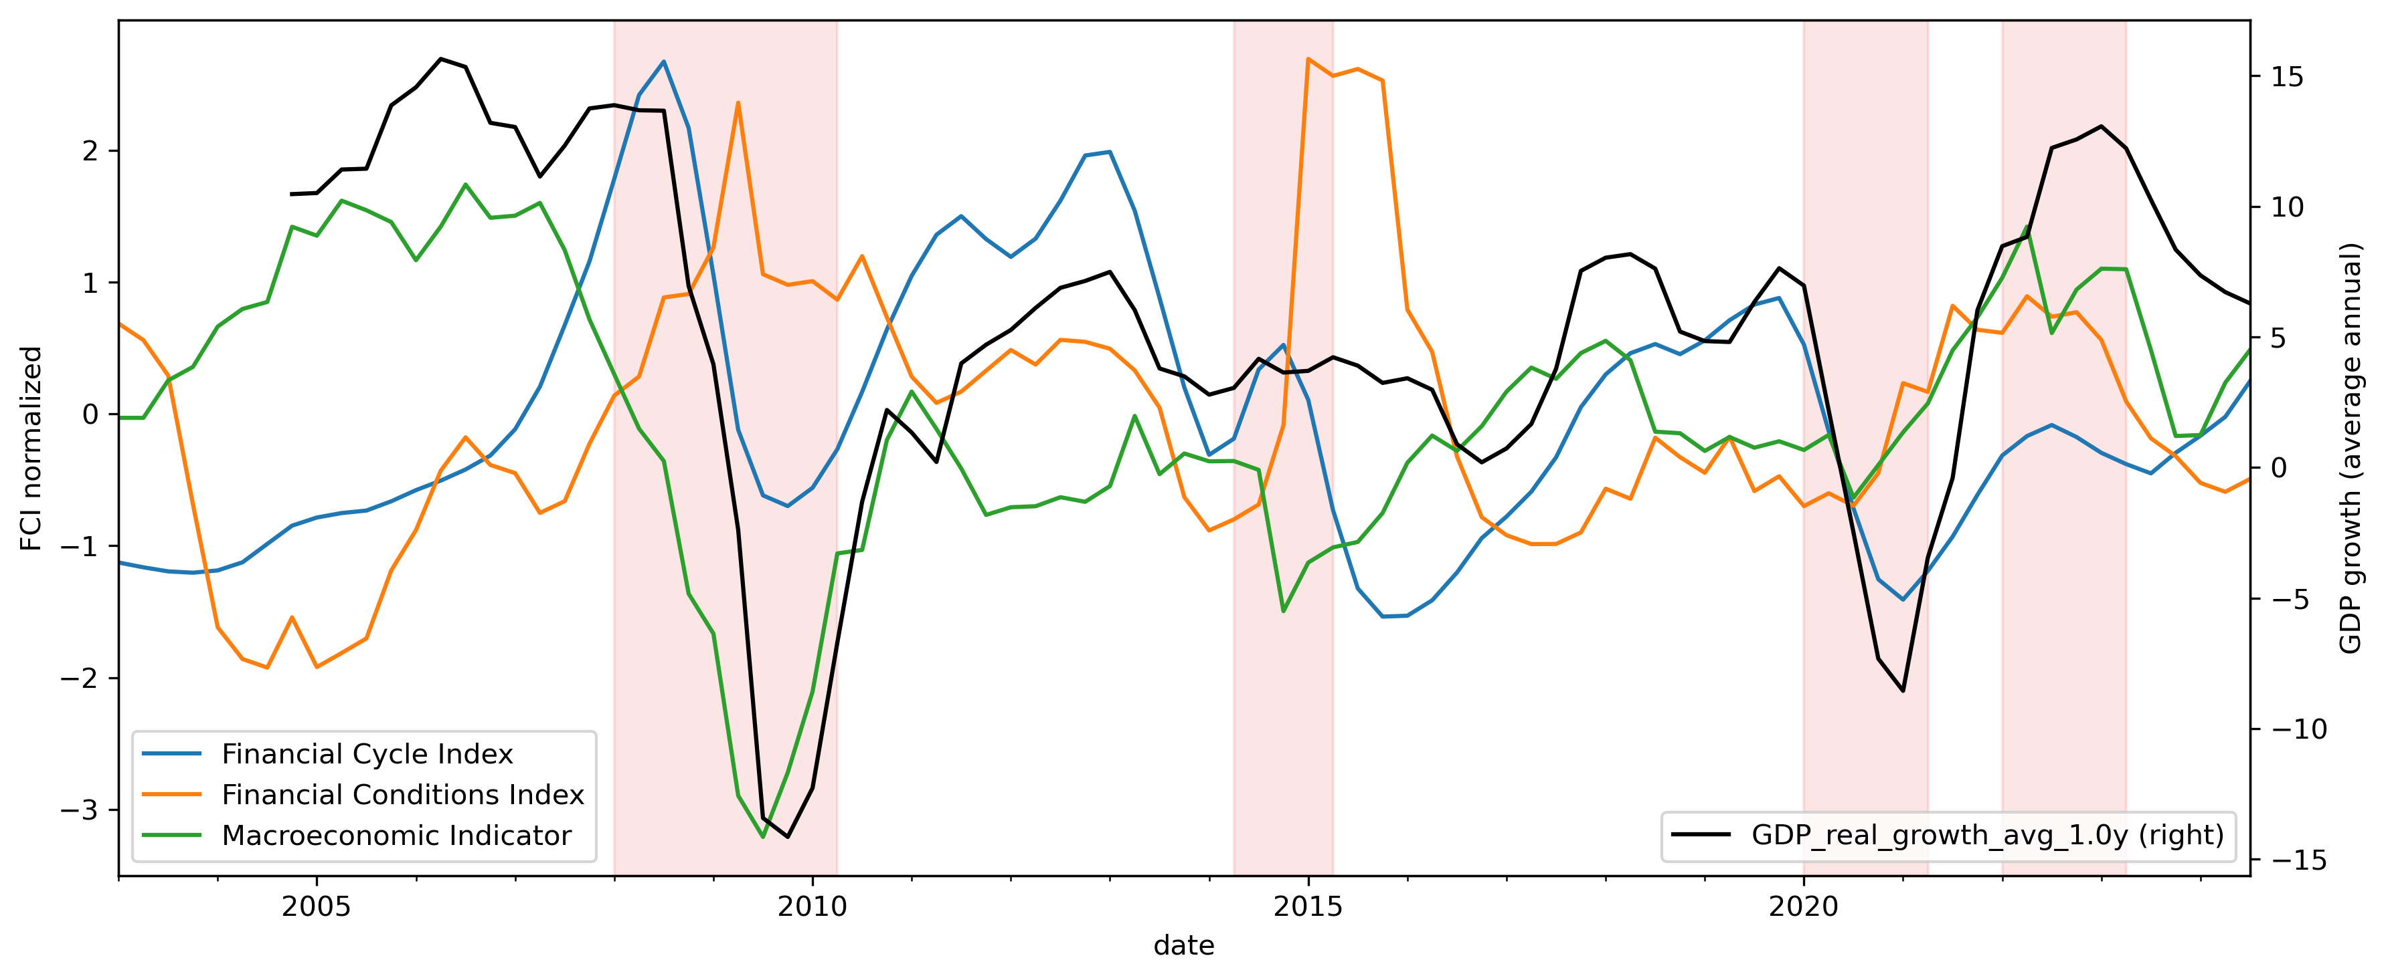
Financial vulnerabilities, stress, external shocks and real GDP growth
The Financial cycle index tracks the risk build-ups in our financial system and is used as a forward looking indicator. The Financial conditions index is meant to show the current tension level in the financial markets. The Macroeconomic indicator captures all other external events that are indirectly related to financial markets.

Slide 3
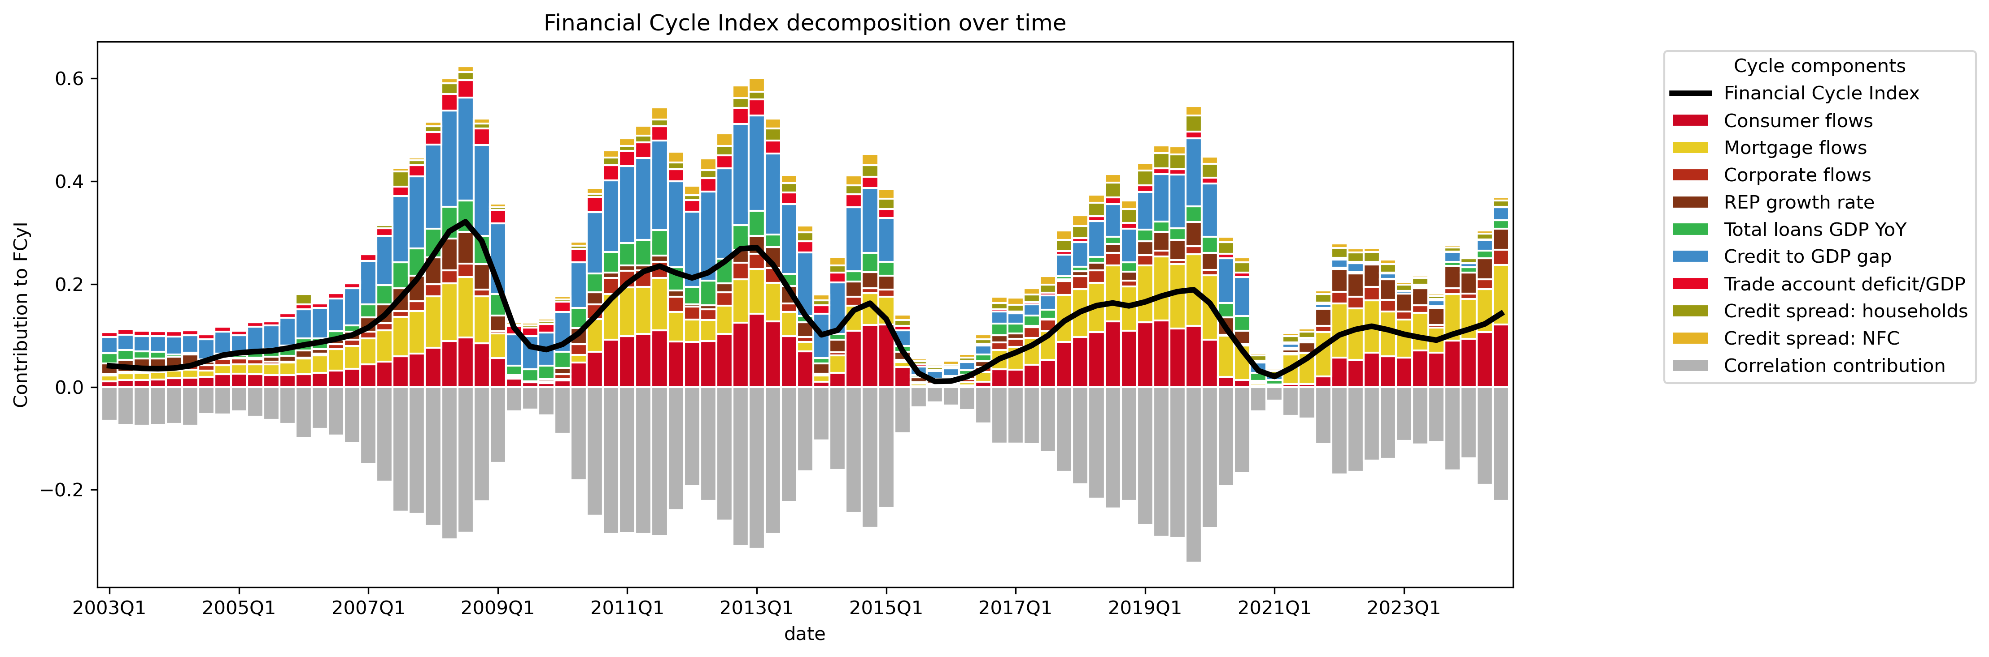
Financial Cycle Index
The FCyI reflects the build-up of systemic risks in the financial system over the medium-to-long term. It measures the accumulation of financial imbalances that could lead to crises or severe downturns.

Slide 4
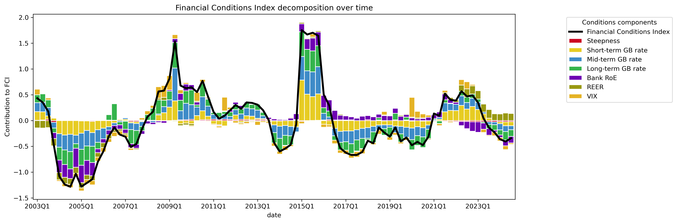
Financial Conditions Index
The FCI captures the current state of financial markets, including the ease or difficulty with which economic agents can access credit and financing (Aikman 2019). It reflects the short-term financial stress or risk levels in the system (ESRB 2021).

Slide 5
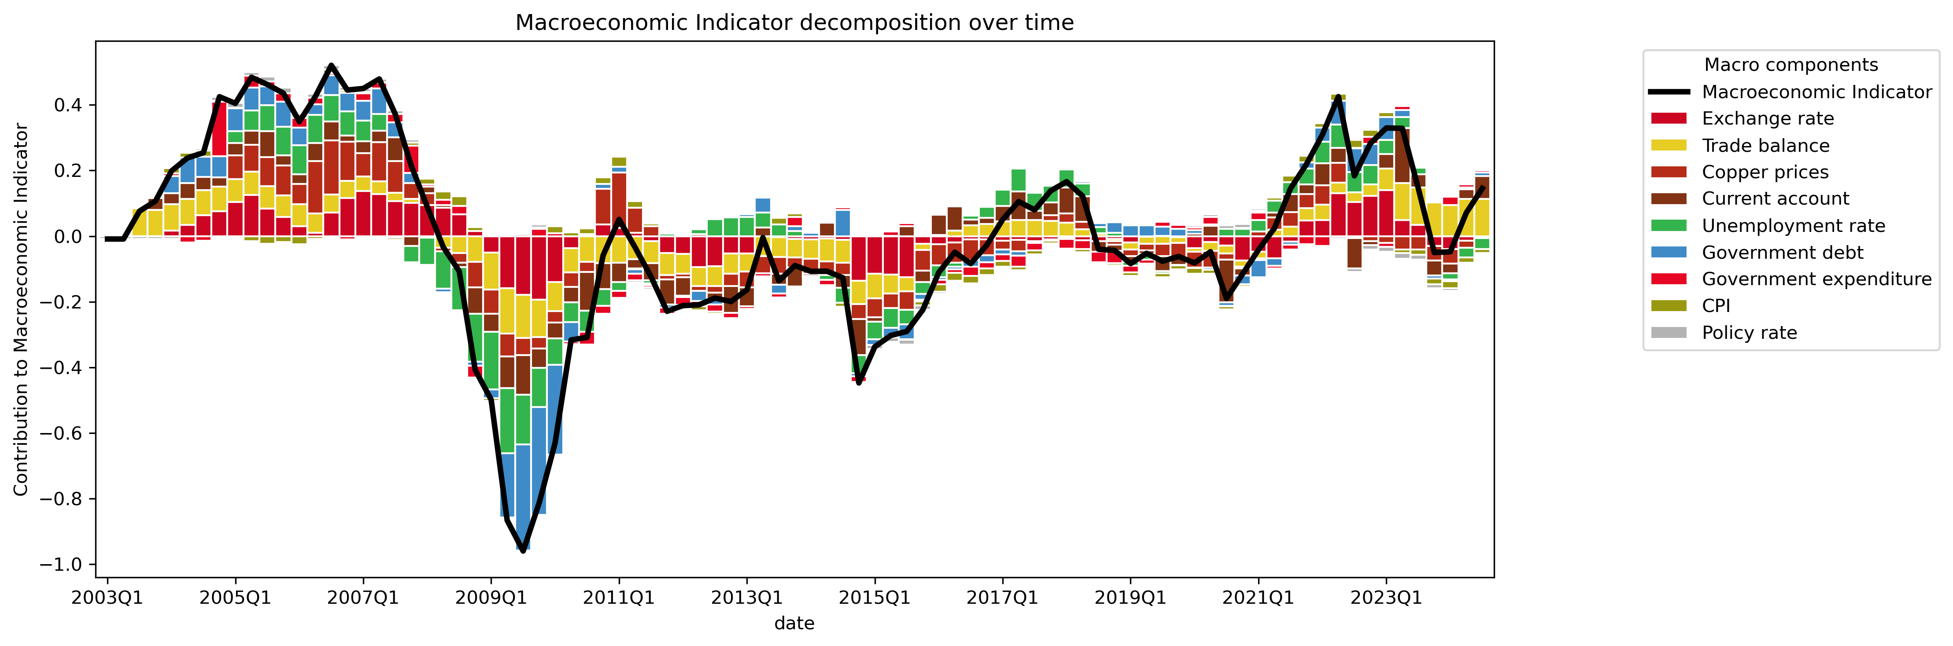
Macroeconomic Indicator
The MI is a composite index that encapsulates key macroeconomic variables, with a focus on external factors critical to the economic performance of a small economy. It incorporates the effects of external demand and supply chain dynamics. It allows for a more holistic assessment of risks to growth.

Slide 6
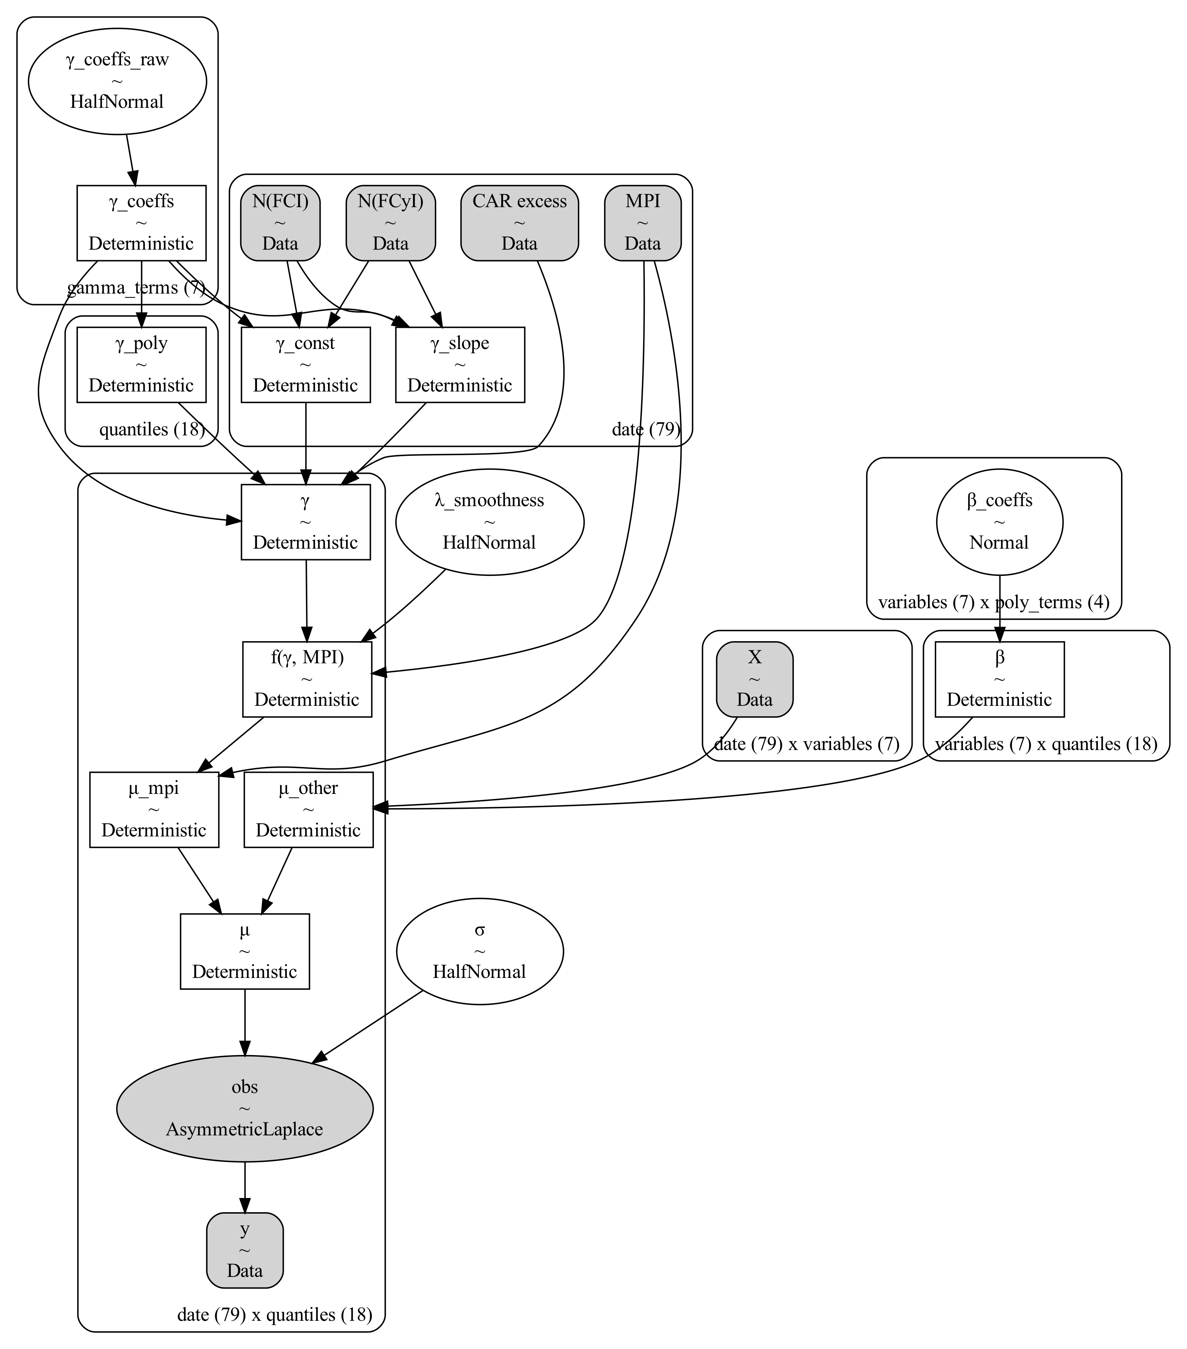
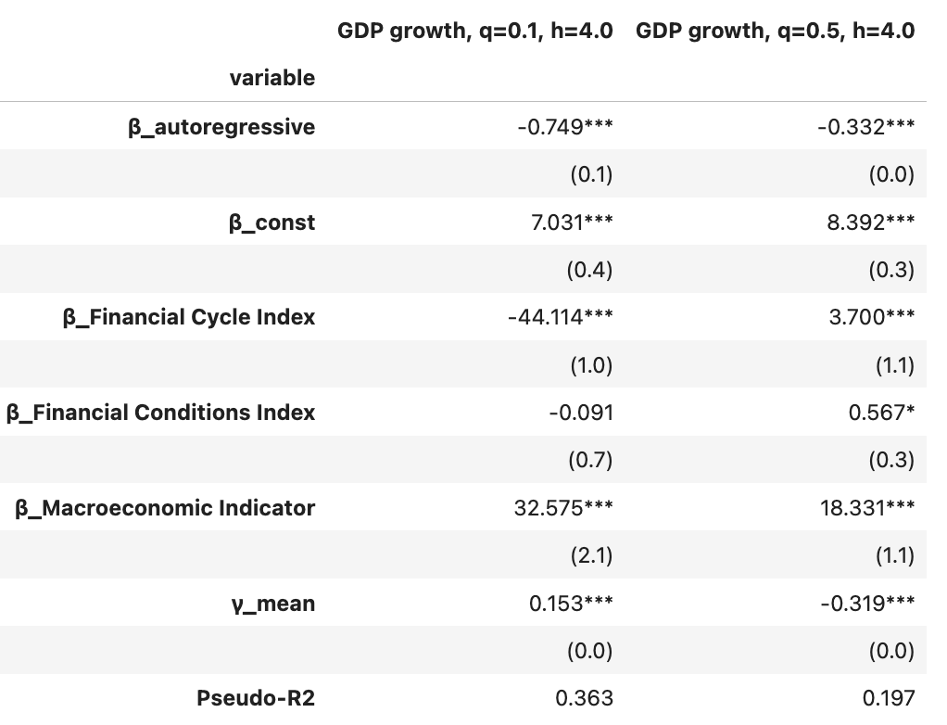
Modeling policy effects with Markov chain Monte Carlo (MCMC)

Slide 7
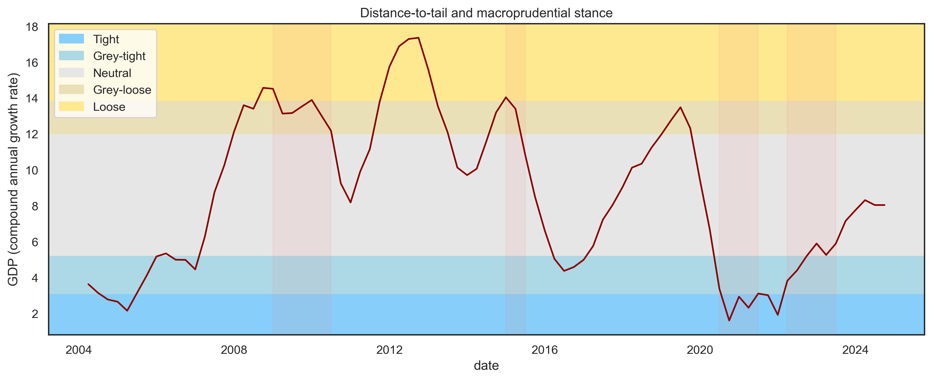
Macroprudential stance
The distance-to-tail metric allows the policymaker to monitor the overall level of systemic risks and respond accordingly to them. The ESRB recommends on comparing them to the resilience of the financial system to facilitate better policy decisions. Currently, systemic risks are at the neutral level, still they display positive trend.

Slide 8
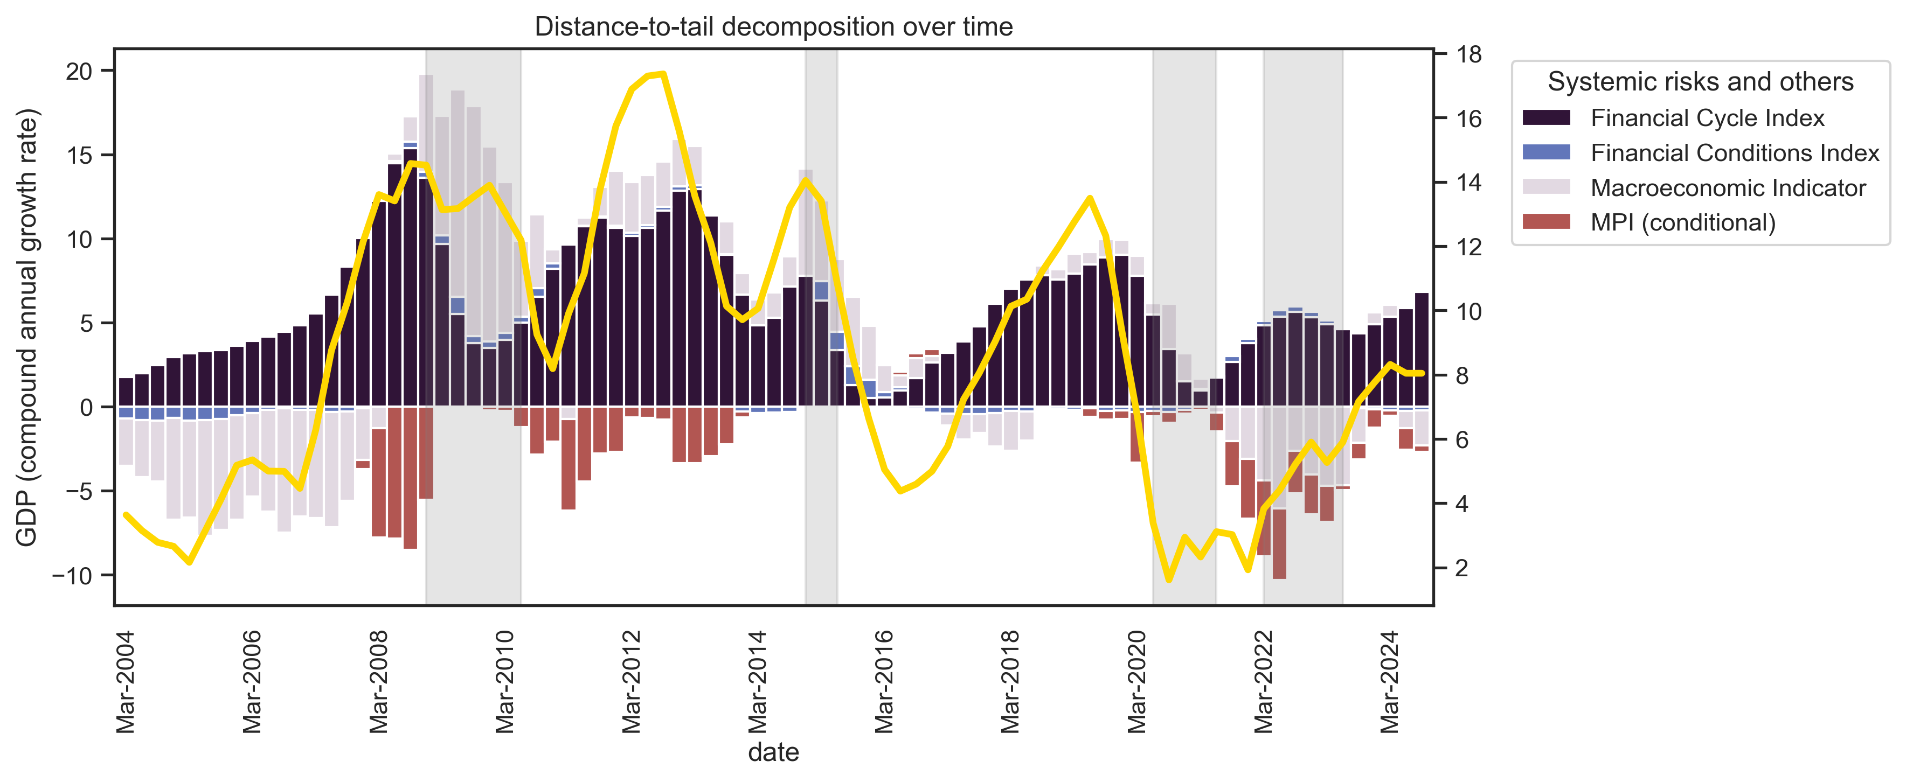
Systemic risks over time
The conditional distance-to-tail allows us to quantify systemic risks and to track them over time. This framework also allows for the decomposition of risks into various types, providing policymakers with the ability to choose instruments more selectively.

Slide 9
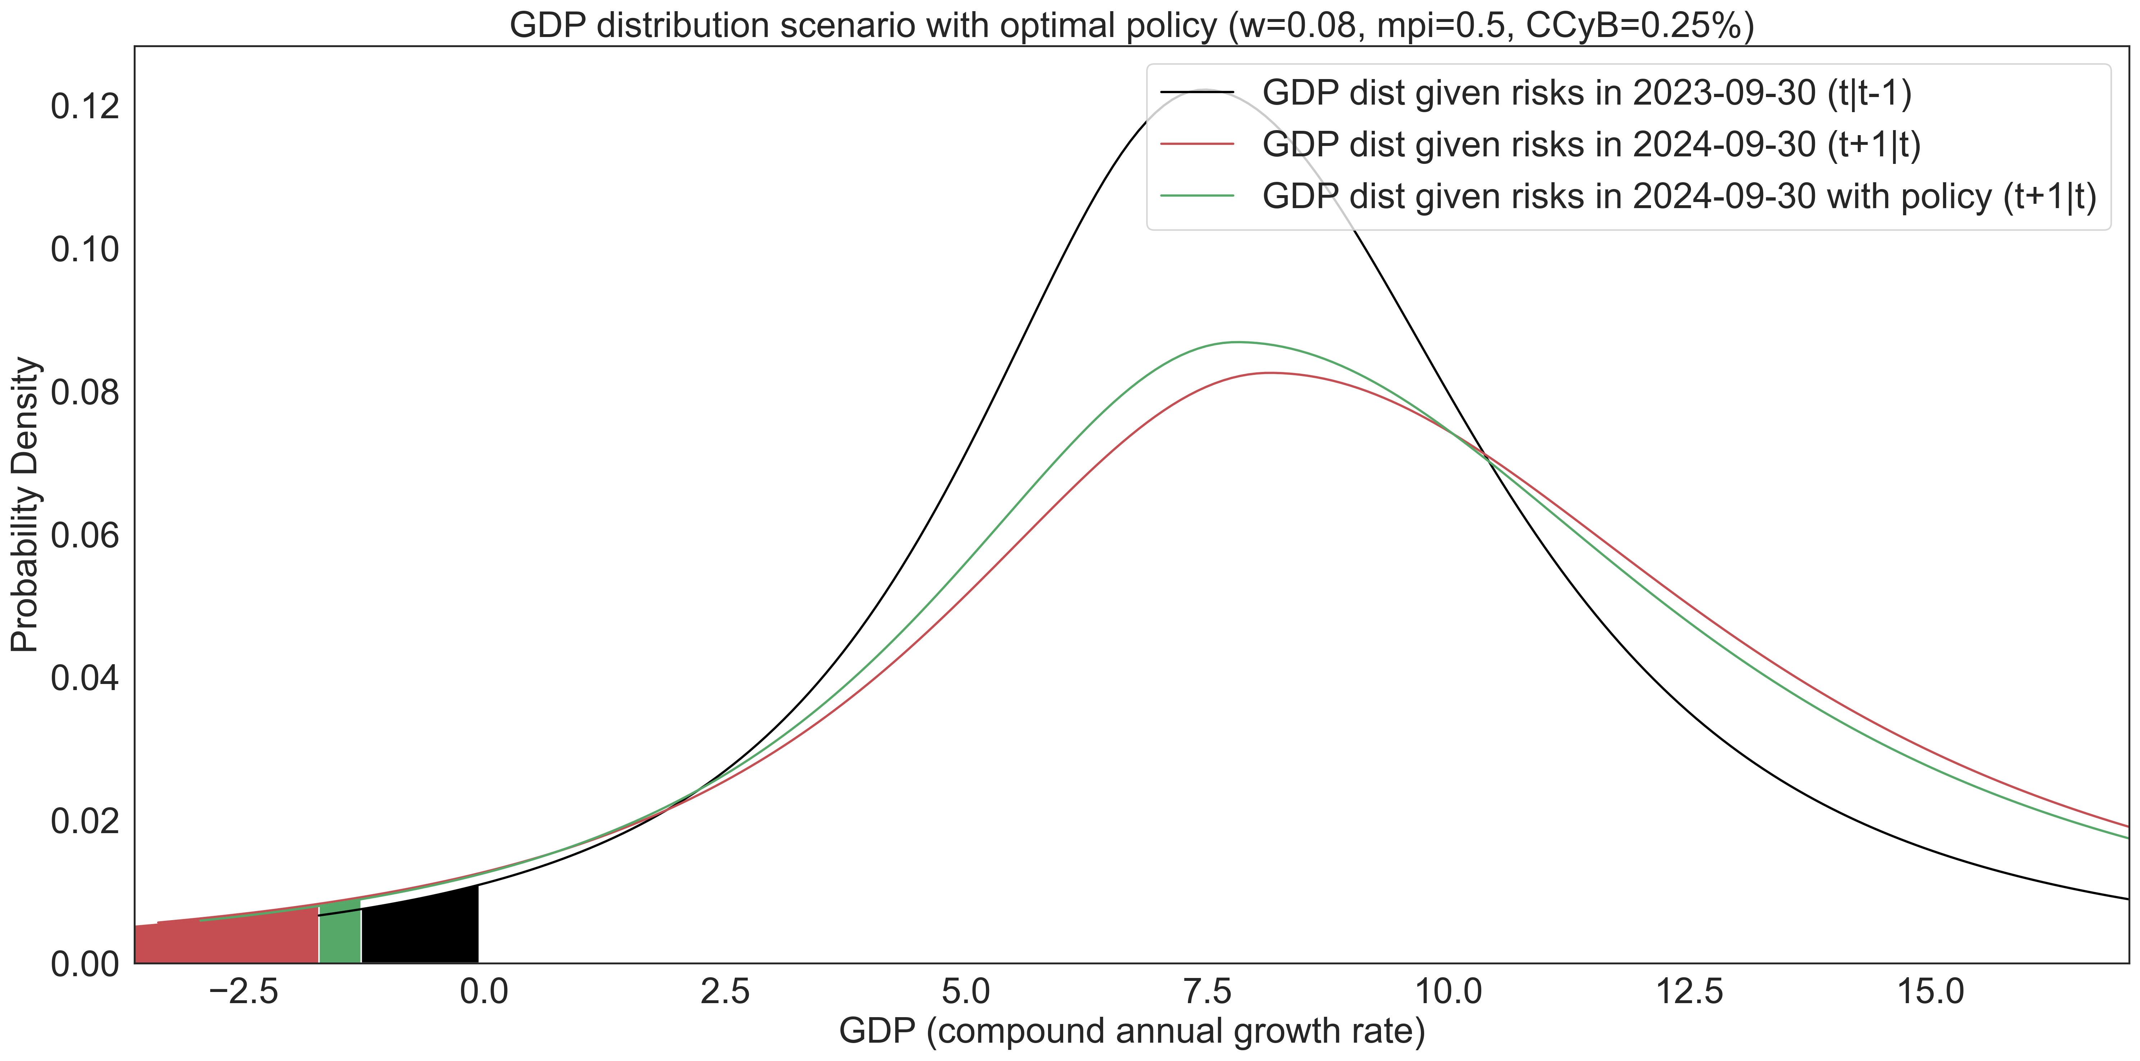
GDP distributions corresponding to systemic risks one year prior. Median: 9.21% --> 8.9% (-0.31%), Gap: 7.93% --> 7.39% (-0.54%).

Slide 10
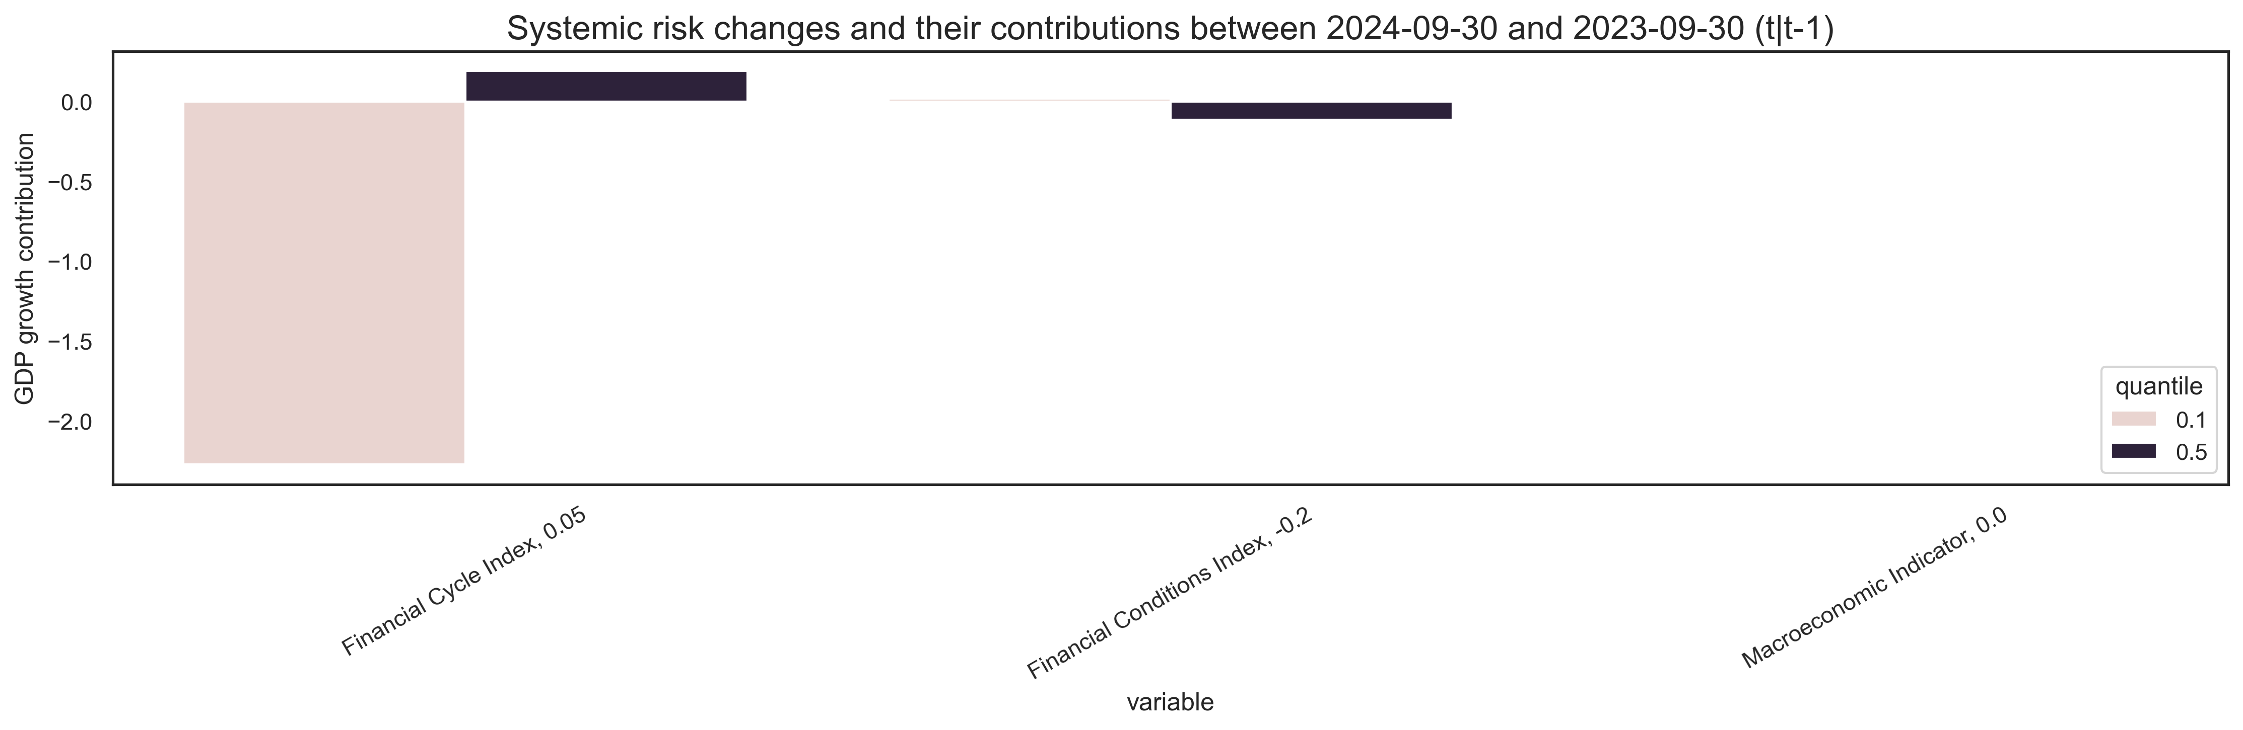
Risks' contribution to expected median and tail
Major risks stem from increasing financial cycles. Additionally, negative externalities may exacerbate these risks through indirect channels.

Slide 11
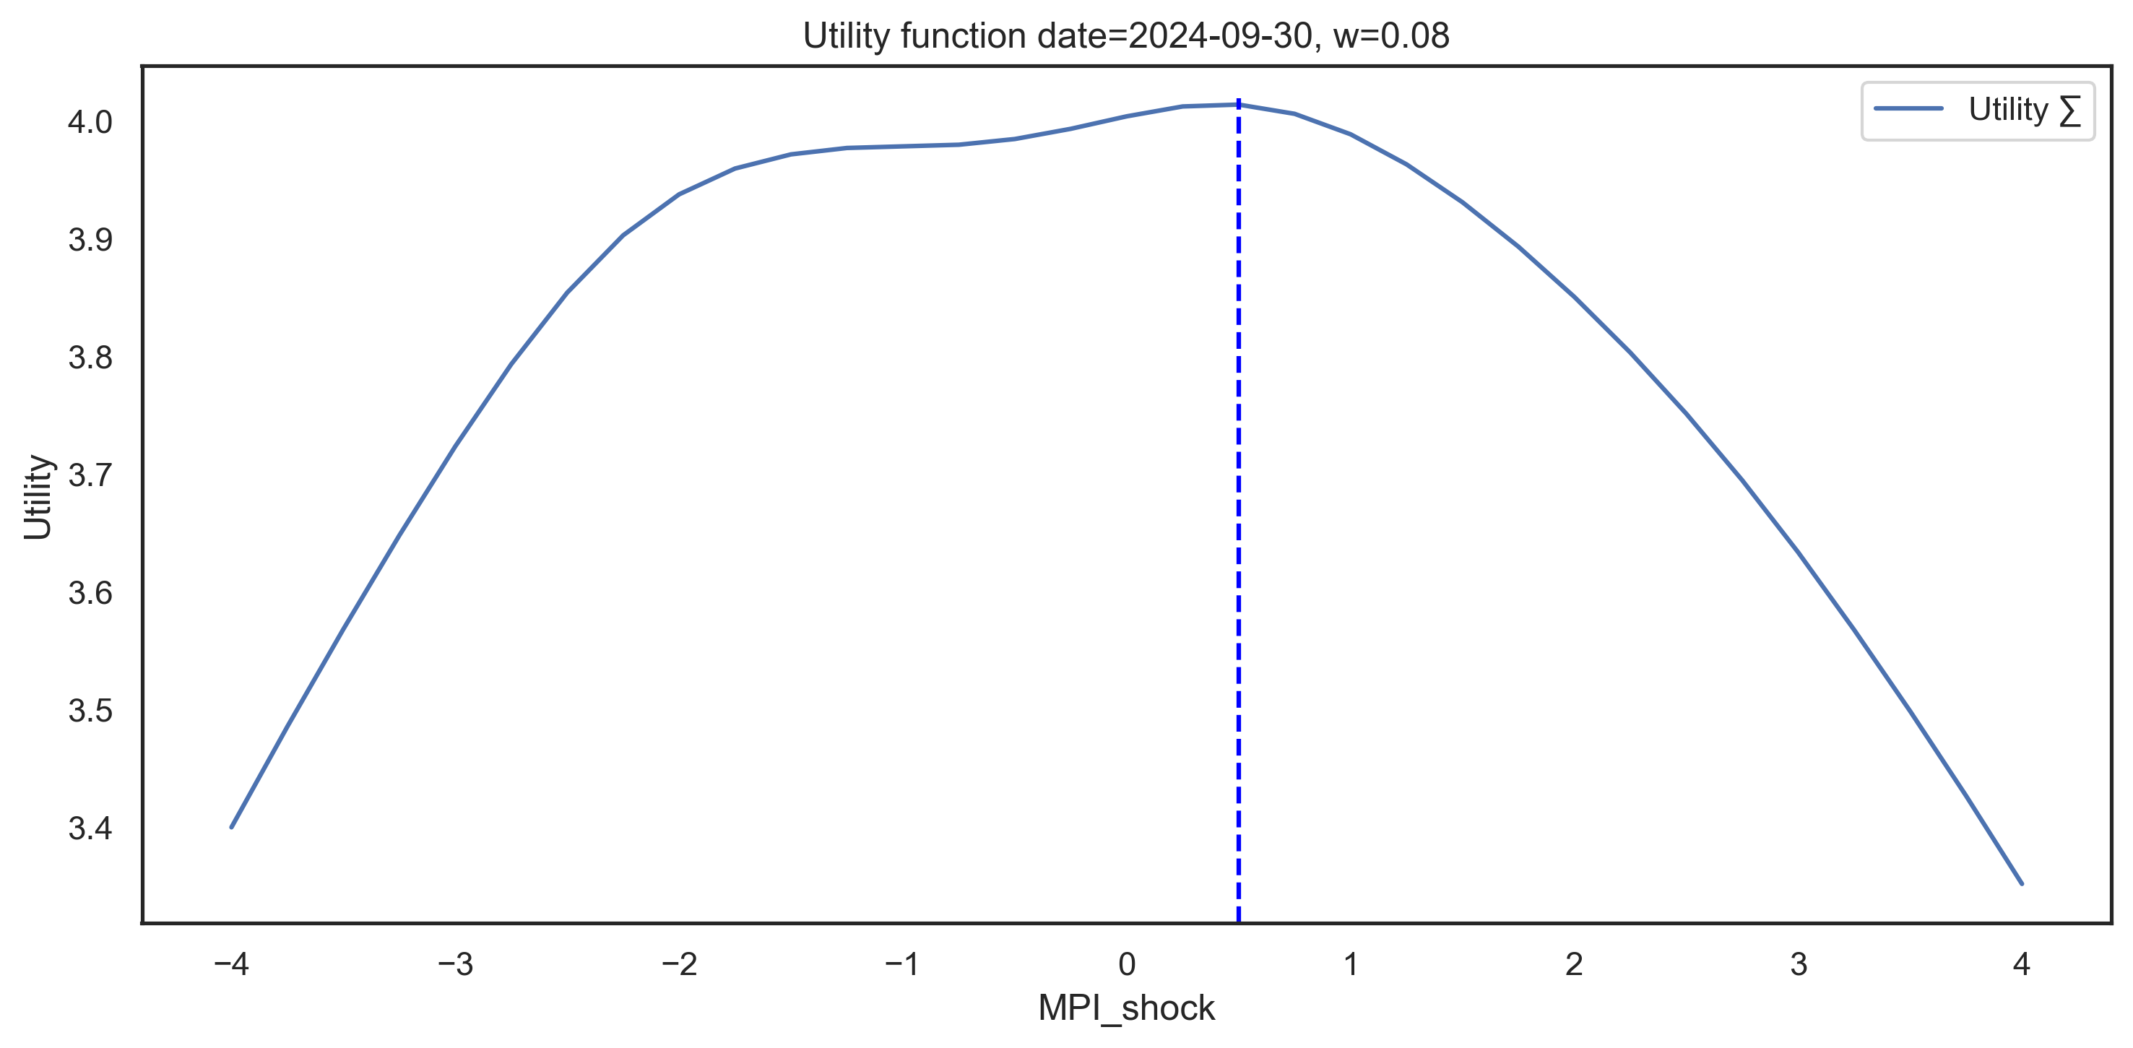
w calibration: Suarez utility function
The Suarez utility function indicates preference for a particular policy action given the policy stance and risk expectations w. Higher values of utility indicate preference towards those polices.

Slide 12
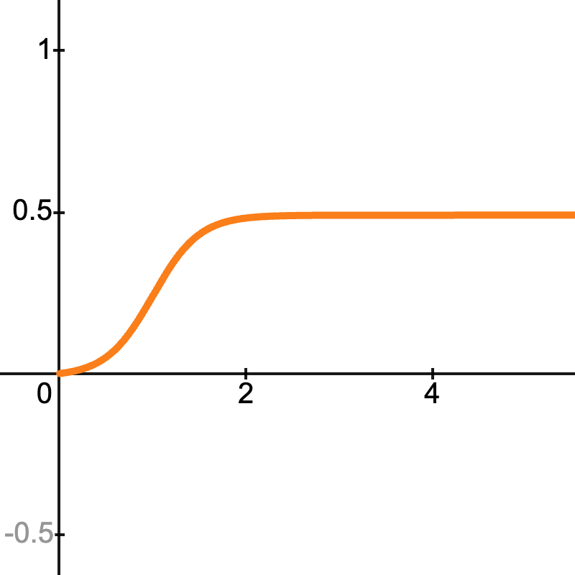
Measuring the effects of macroprudential policy: theory
Macroprudential policy has nonlinear effects on growth. These effects can be different depending on the current level of FCyI, FCI and excess CAR.
FCyI: The greater the build-up of financial vulnerabilities, the more impactful a tightening policy will be.
FCI: A loosening policy is more effective during periods of strong financial stress. Additionally, during periods of low financial stress the negative effect of a tightening on the median is much lower.
excess CAR: Banks with CAR values closer to the minimum requirement will respond more strongly to changes in CCyB compared with banks with higher excess CAR.
Endogeneity: A policy action involving one large step usually results in stronger outcome compared to using multiple small steps (it is greater than the sum of its parts).

Slide 13
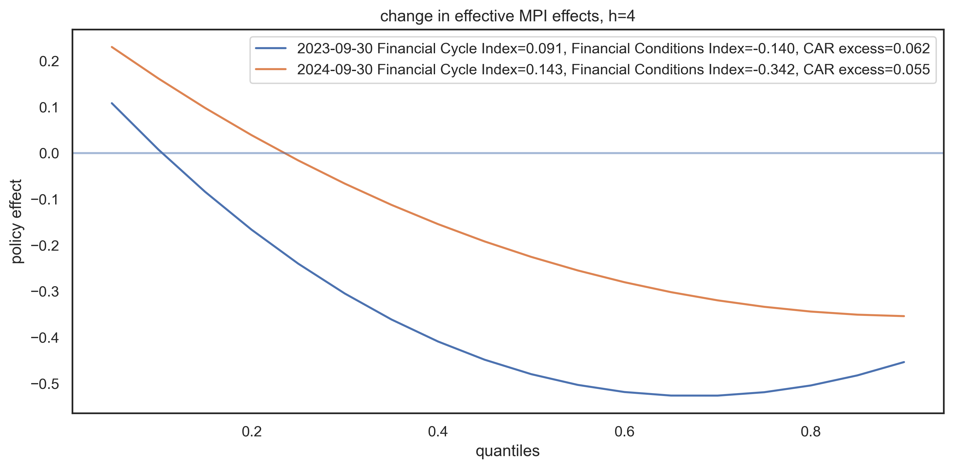
Effectiveness of macroprudential policy
Macroprudential policy has different effects depending on the quantile of the GDP growth distribution. Usually this effect is positive for the tail and negative for the median, but the outcome changes over time, conditional on FCyI, FCI and CAR.

Slide 14
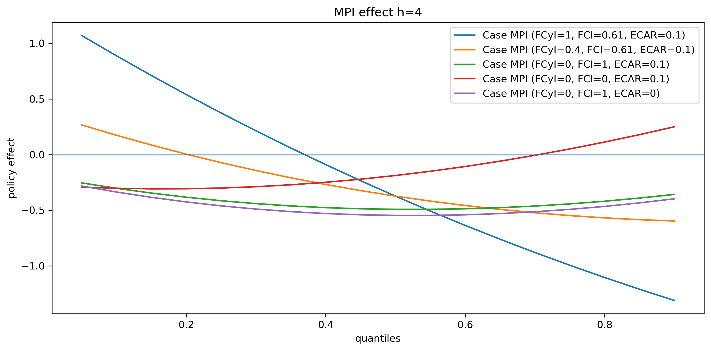
Effectiveness of macroprudential policy
We display the effects of macroprudential policy through different phases of the financial cycle in the figure below. The cases include: maturity, expansion, recession, recession without stress and severe recession.

Slide 15
Recommendation

Slide 16
Thank you

Slide 17
Appendix

Slide 18
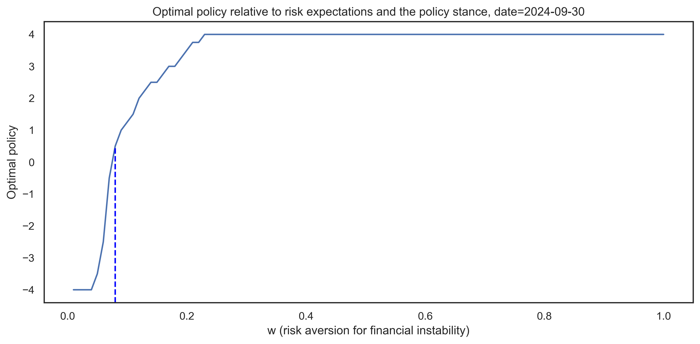
w calibration: Risk aversion interval relevant for policy decisions
w represents the policy stance and risk expectations of the policymaker. As such, it should change slowly over the financial cycle. If the policymaker believes there is a fundamental change in risks, then they should change w accordingly.

